Slide 1



Slide 2
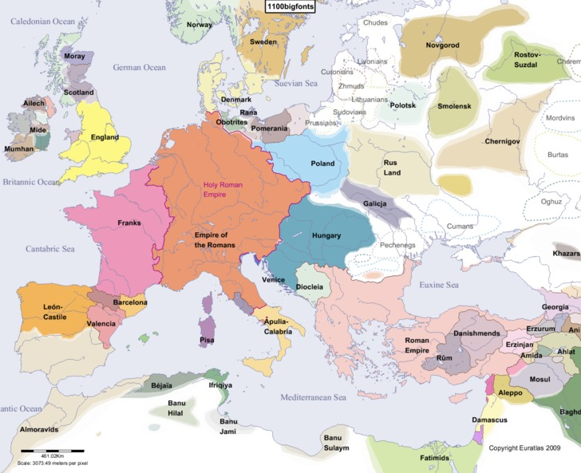

Slide 3
England
Area settled by the Angles and Saxons
Alfred the Great – unites the Anglo-Saxon kingdoms
BUT the last A-S king dies without an heir

Slide 4
William the Conqueror – from Normandy
  (An area the Vikings settled in France)
He leads Norman Conquest of England in 1066 C.E. – He wins the Battle of Hastings to control England

Slide 5

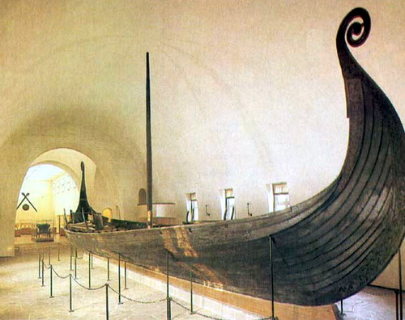
The Vikings

Slide 6
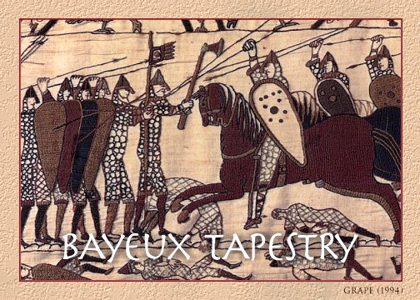

Slide 7
England
Henry II
  Common law system
  (the same law throughout the country)
  claimed right to try the clergy in royal courts

Slide 8
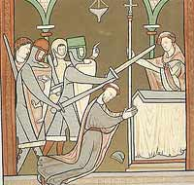

Slide 9
England
Magna Carta – 1215
  Henry’s son, King John, was forced to sign the Magna Carta
  The Magna Carta
    limited royal power
    said that the king can’t collect taxes without the legislative consen
    Guaranteed the right to trial by jury

Slide 10
France
Was NOT a nation, but a collection of small feudal lands
In 987 C.E.– Hugh Capet elected to throne by nobles – began the Capetian family rule.
The “Capetians” expand control
  enlarged territory
  appointed officials
  had exclusive right to make coins and wage or make war

Slide 11
Spain
3 kingdoms: Portugal, Castille, Aragon
1469 C.E. – Ferdinand of Aragon married Isabella of Castille
decide to unite kingdoms

Slide 12
Spain
achieve religious unity through
  no toleration
  Inquisition – church court set up to try heresy cases
  Jews and Muslims kicked out of Spain or burned at stake

Slide 13
Russia
Mongols had ruled Russia as part of Asian empire
Ivan III (Ivan the Great)
  threw off Mongol rule
  centralized power
  expanded Russian nation
Orthodox Church unified

Slide 14
Hundred Years’ War
when: 1337 – 1453
who: England vs. France
why: conflicts over French lands and crown
English were winning at first due to superior weapons

Slide 15
Hundred Years’ War
Joan of Arc
  said heavenly voices told her to save France
  led a French army to victory at Orleans
  captured by English, burned for witchcraft
  inspired French to rally, drive English out of France

Slide 16
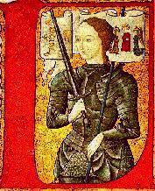
Joan of Arc

Slide 17
Hundred Years’ War
Effects
  each country feels unity
  helps decline of feudalism
  more people in towns
  new middle class willing to pay taxes for armies

